Slide 1
Title: Power Plant Efficiency Prediction Using MrMiMaxG Feature Engineering and Consensus Voting Mechanism
Power plant efficiency, specifically in Coal-Fired Power Plants (PLTU), indicates how effectively the plant converts fuel energy into electrical energy, which is generally determined by Boiler Efficiency and Net Plant Heat Rate (NPHR).
Boiler Efficiency can be analogized to the State of Health (SoH) of a battery, which represents the battery's capability or remaining capacity to store and discharge electrical energy. In this analogy, coal acts as the primary fuel supplier, similar to the energy stored within a battery.
Meanwhile, the driving range (in km) of an electric car or motorcycle is determined by the battery's capacity and its ability to power the motor. The fewer kilowatt-hours (kWh) or Ampere-hours (Ah) consumed to travel 1 km, the better the vehicle's efficiency. This ratio of travel distance efficiency to battery capacity consumed is analogous to the Net Plant Heat Rate (NPHR) value in a coal-fired power plant.

Slide 2
NPHR
GPHR
NTHR
GTHR
Boiler Efficiency
Gen
GT
Steam
UAT
Fluegas
HP Turbine
Cold Reheat
APH
Boiler
Hot Reheat
IP Turbine
IP Turbine
Air
Coal
LP Turbine
LP Turbine
Condenser
Condenser
Feedwater

Slide 3
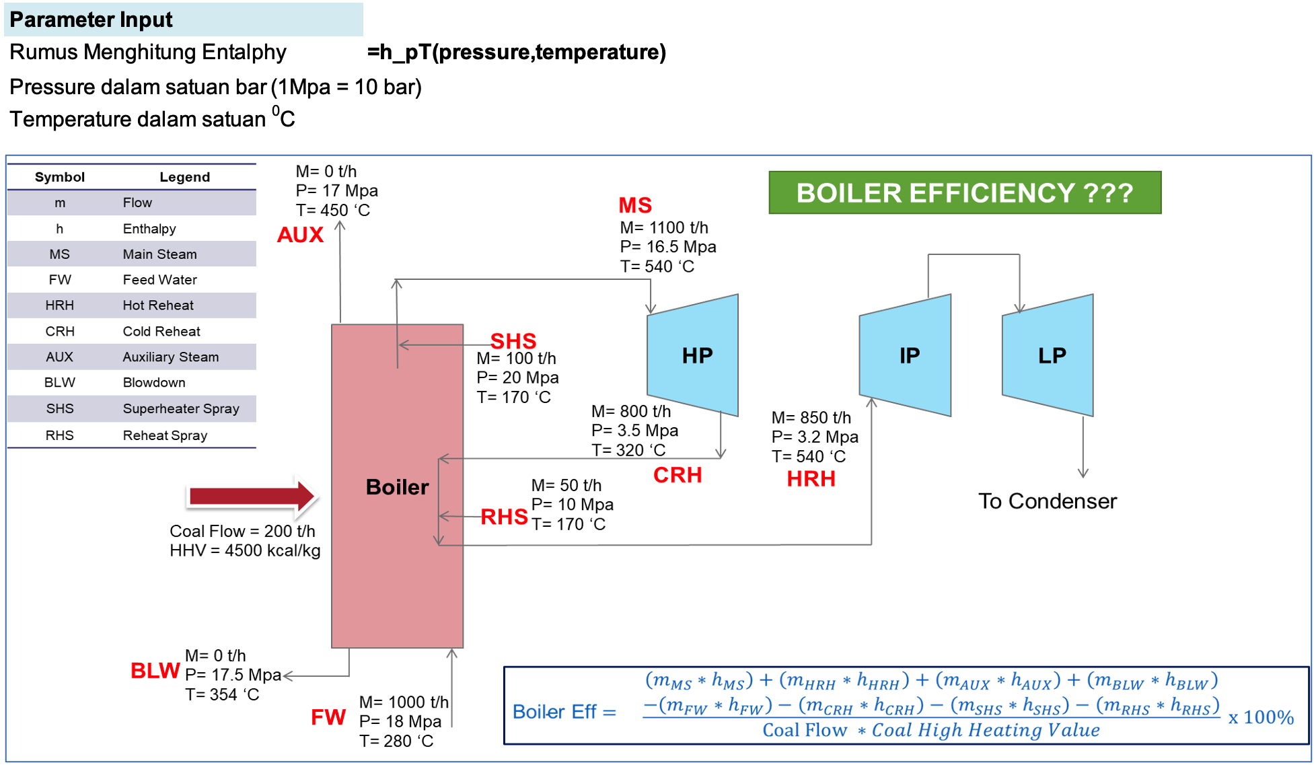

Slide 4
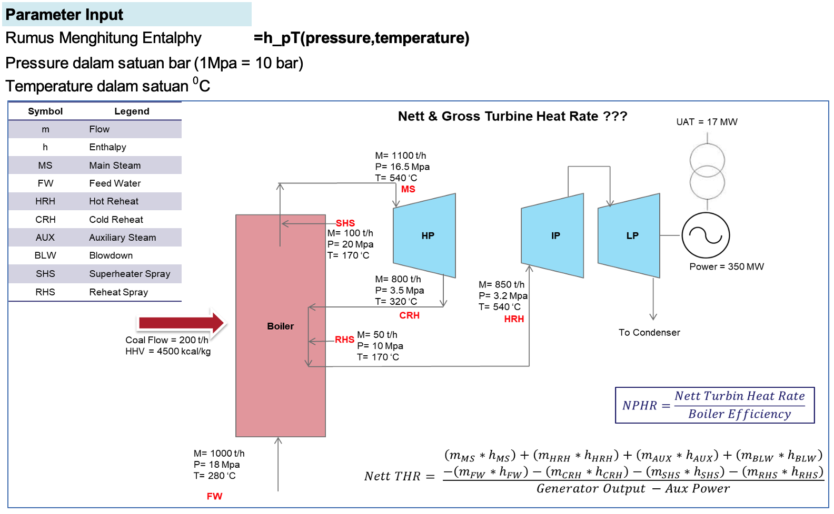

Slide 5
